Slide 1
Modelling Data with Machine Learning
Kyle Martin

Slide 2
Representing Data to Make Decisions
You have already looked at the different types of data that might exist
Structured vs Unstructured, different types, etc
And explored methods for pre-processing data
i.e. Cleaning, resolving redundancies, etc
Let’s look at methods of making judgments about data
Modelling data to anticipate an outcome
I.e. Machine Learning

Slide 3
What We Will Learn
What is Machine Learning?
What is similarity-based ML?
What is Deep Learning?

Slide 4
Machine Learning

Slide 5
Introduction
AI and ML algorithms are used to empower our everyday lives in many areas

Slide 6


Introduction
AI and ML algorithms are used to empower our everyday lives in many areas
Recommender systems for streaming services

Slide 7
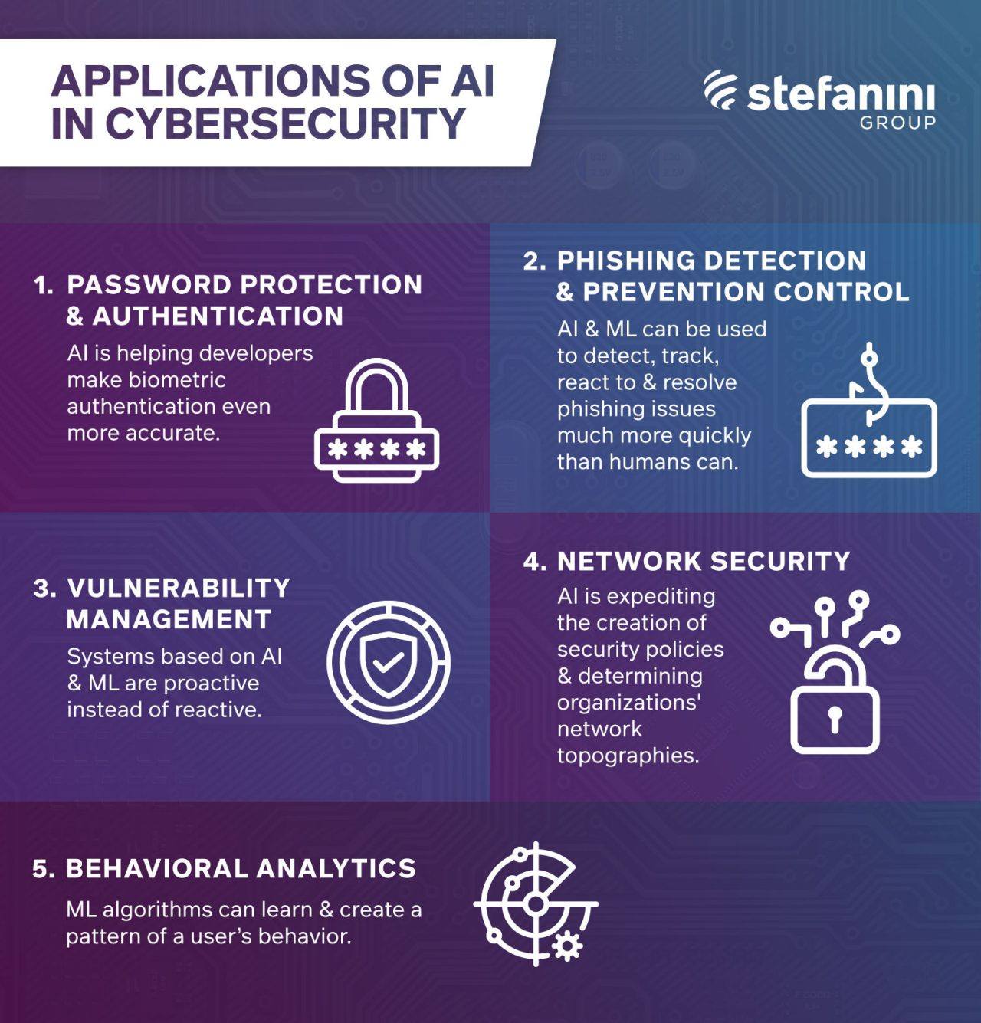
Introduction
AI and ML algorithms are used to empower our everyday lives in many areas
Anomaly detection for cyber security

Slide 8

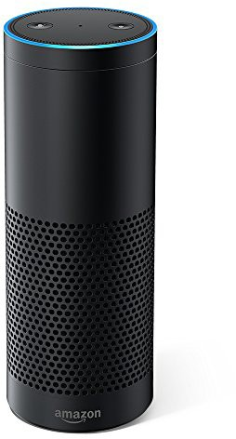
Introduction
AI and ML algorithms are used to empower our everyday lives in many areas
ASR, NLP and NLG for home assistants

Slide 9
AI in Industry
AI is also at the heart of advancements in industry
A key part of the Third Industrial Revolution
Or Digital Revolution as it is sometimes called
By 2025, the AI industry is expected to be worth approx. $200 billion

Slide 10
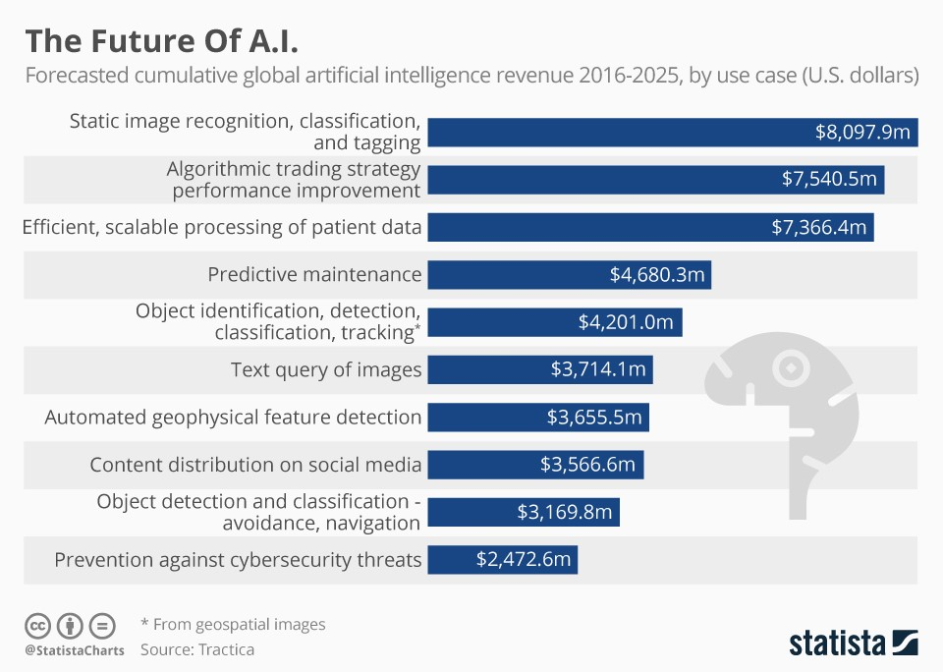
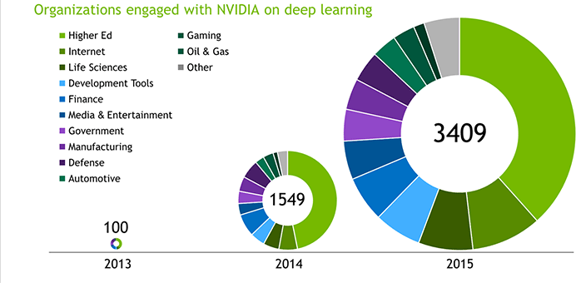
The Future of AI
(Image courtesy of nvidia)
(Image courtesy of statista)

Slide 11
Artificial Intelligence
AI can broadly be considered as the concept of developing artefacts which are capable of performing tasks that typically require human intelligence
Intelligent behaviour includes perception, reasoning, learning, communicating and acting (in ways similar to humans)
Intelligence != sentience
(Nilsson, 1998)

Slide 12
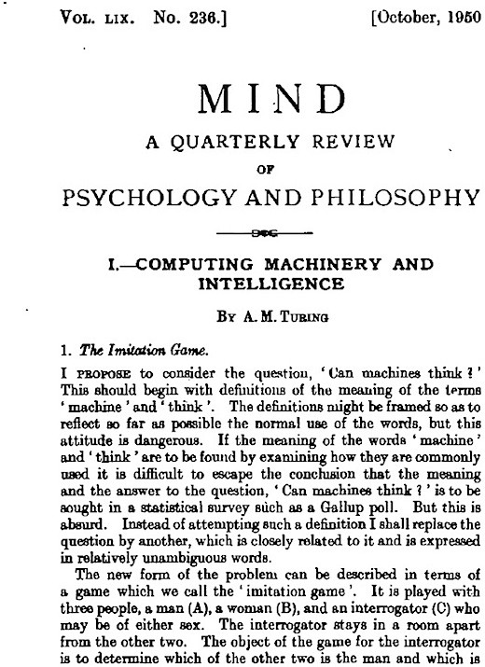
Modern History of Artificial Intelligence
A.M. Turing published "Computing Machinery and Intelligence" (1950). - Introduction of Turing Test as a way of operationalizing a test of intelligent behaviour.
“I believe that the attempt to make a thinking machine will help us greatly in finding out how we think ourselves.”

Slide 13
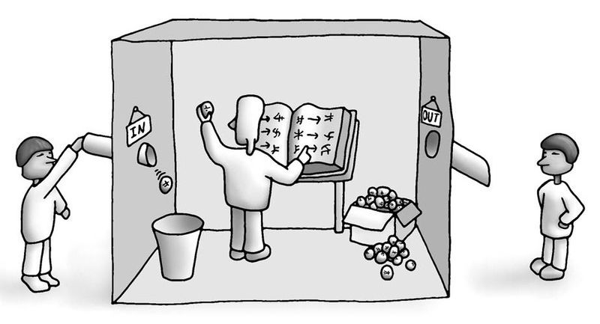
Modern History of Artificial Intelligence
Chinese Room - thought experiment purposed by John Searle in 1980
Given that we have constructed a machine that behaves as though is understands Chinese, it convinces a Chinese speaker that it speaks Chinese

Slide 14
Modern History of Artificial Intelligence
Chinese Room - thought experiment purposed by John Searle in 1980
Given that we have constructed a machine that behaves as though is understands Chinese, it convinces a Chinese speaker that it speaks Chinese
Now replace the machine with a human in a box
Can we say that the human ‘knows’ Chinese?

Slide 15
Artificial General Intelligence
The large historical discussions we remember are generally aimed towards ‘artificial general intelligence’
I.e. an AI capable of doing many different tasks like a human
But we’re not at that point yet
There is no silver bullet algorithm to suddenly build the terminator
Modern research has breaks down a big problem into smaller tasks and attempts to find an appropriate way for the machine to solve each task (usually with different algorithms)

Slide 16
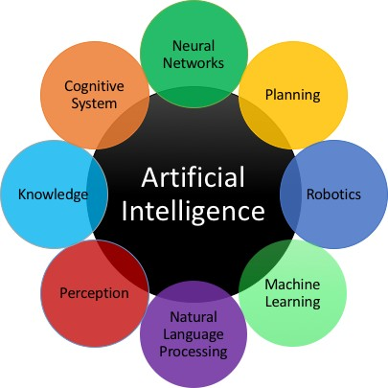
AI Topics
Artificial intelligence is a science and technology based on disciplines such as Computer Science, Biology, Psychology, Linguistics, Mathematics, and Engineering

Slide 17
AI Topics in this Module
AI is a vast field, so we will not cover all of those topics
We will be focussing on one key area:
Machine Learning
And two relevant topics within that
Instance-Based, Model-Based

Slide 18
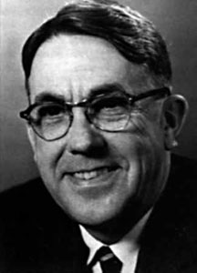
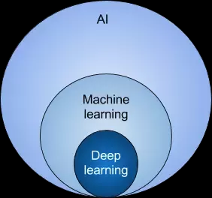
Machine Learning
In 1959, Arthur Samuel, MIT: ”the field of study that gives computers the ability to learn without being explicitly programmed."
ML is based around the idea that we should really just be able to give machines access to data and let them learn for themselves

Slide 19
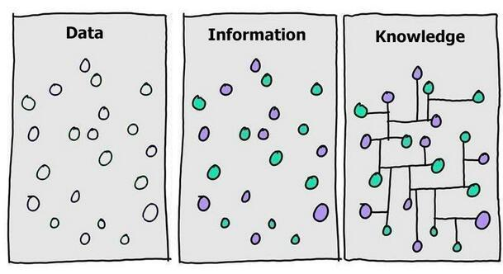
Data, Information and Knowledge
Data is a specific, individual fact
An apple is a fruit
Information is a combination of facts within a given context
An apple is a fruit which grows on trees
Knowledge is understanding of information and its significance
Since an apple is a fruit and it grows on trees, other fruits probably grow on trees

Slide 20
Machine Learning Algorithms
Supervised Learning
Unsupervised Learning
Reinforcement Learning

Slide 21
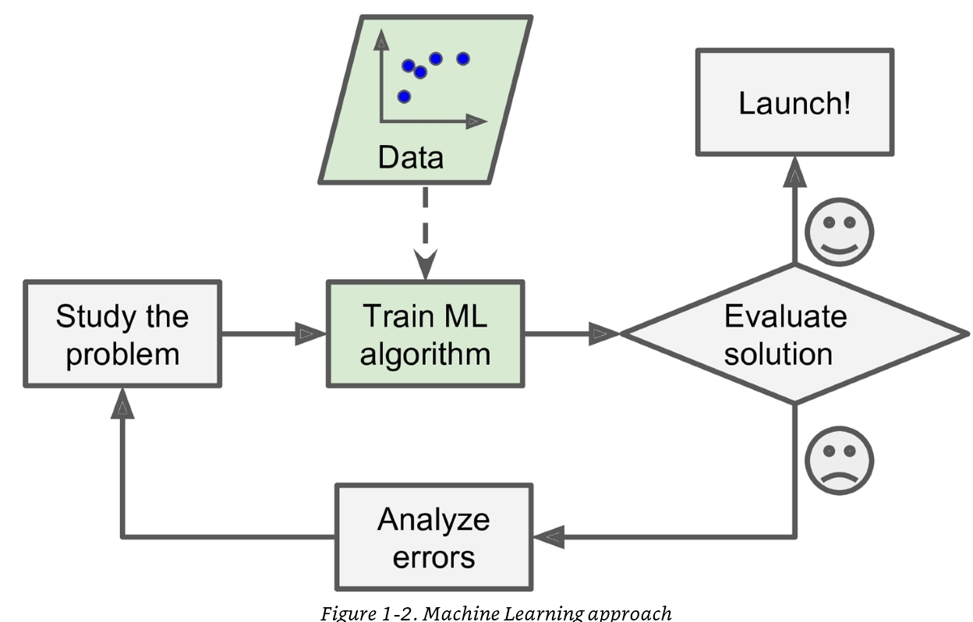
Machine Learning Approach
(Image courtesy of Aurelien Geron, ML book)
Notes:
Consider how might you develop a spam filter?
Once you study the problem you may find some correlations between certain occurrences of words in your email to whether or not the email is spam. Thereafter you would add these as email filter rules.
Maintaining and creating such rules can be manually demanding
Would it not be great if a machine can adapt itself to detect spam automatically?
A ML technique would learn these patterns automatically by comparing the frequency of certain words appearing in spam versus non –spam.
It needs an evaluation method to identify errors in email classification and eventually establish confidence in its ability to accurately filter email into the spam and ham classers correctly, before it can be launched.
Unlike before the human need only provide a class label for each email ; stating whether its spam or ham; this means the demand on the human is significantly less because there is no need to write hard coded rules.
Generally based on the level of human supervision we can categories machine learning algorithms as being supervised; unsupervised; semi-supervised or reinforcement learning.

Slide 22
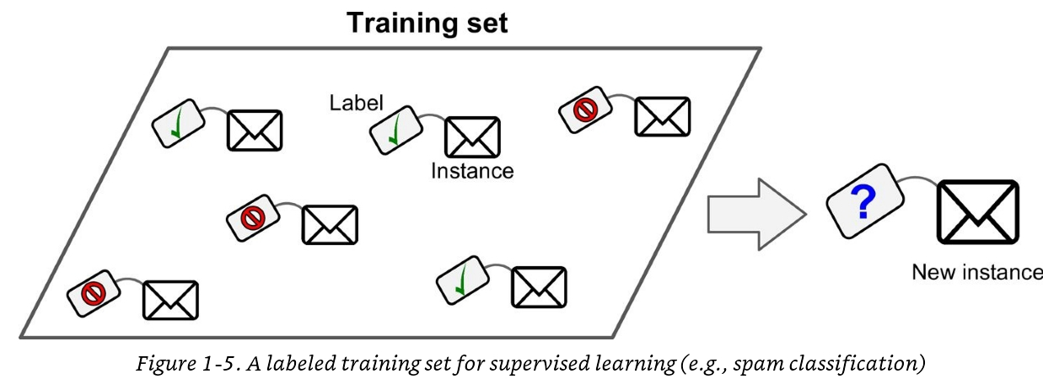
Supervised Learning
Supervised learning - Need a labelled training set to learn from
(Image courtesy of Aurelien Geron, ML book)
Notes:
A typical supervised learning task is classification like the classification of emails into either spam or ham
Given a new instance the task is classifying it as either spam or not spam.
Each attempt at doing this task by the machine allows it to gain experience in doing this task
The number (or fraction) of emails correctly classified as spam/not spam by the program can be viewed as a performance metric
– note this usually requires there to be a data set of emails together with a spam/not spam class label associated to each email; we refer to this as the training set from which the ML algorithm can learn.
Each email must be converted into what is called an instance where an instance has a set of features ;
for instance each word in a some dictionary with a binary value to indicate whether or not that word is present in the email.
The class feature will simply state spam or not spam.
A collection of such data instances form the training set.

Slide 23
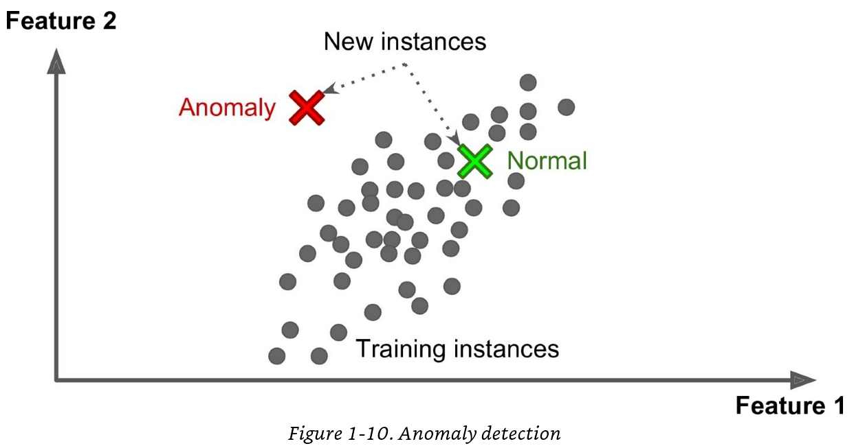
Unsupervised Learning
Labels are unavailable
No knowledge of ground truth or outcome
Can we still learn?
Yes!
For example, identify patterns
(Image courtesy of Aurelien Geron, ML book)

Slide 24
Unsupervised learning algorithms
Clustering
K-means
Hierarchical cluster analysis
Expectation maximisation
Visualisation and dimensionality reduction
Principal Component Analysis
Local linear embedding
Association Rule Learning

Slide 25
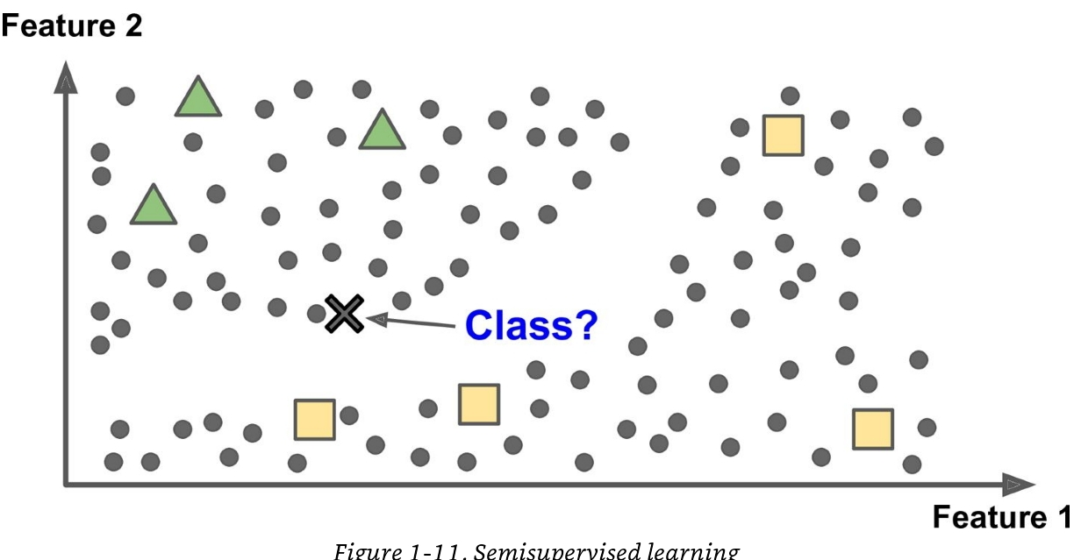
Semi-supervised learning
(Image courtesy of Aurelien Geron, ML book)

Slide 26
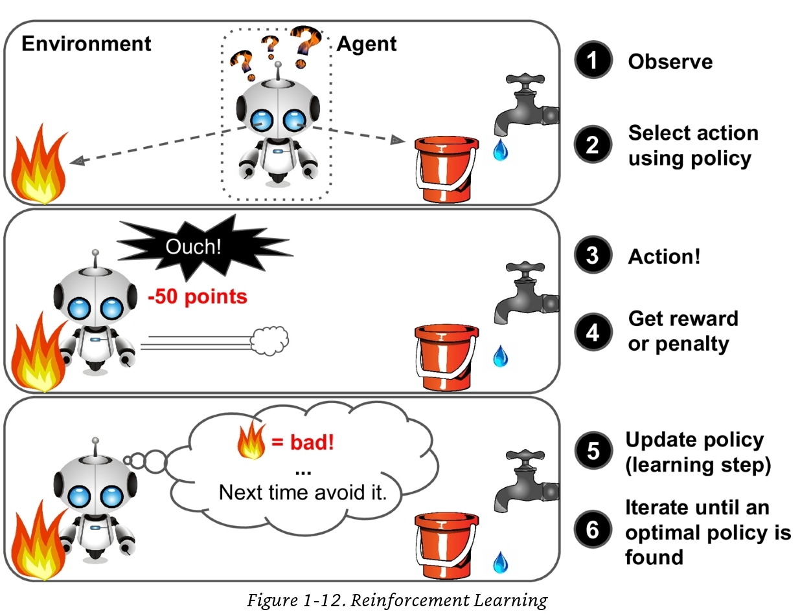
Reinforcement Learning
Train a model/agent to solve a problem based on trial and error
Reward vs penalty
(Image courtesy of Aurelien Geron, ML book)

Slide 27
Challenges for machine learning
Insufficient quantity of training data
Non representative training data
Poor quality data
Irrelevant features
Overfitting and under fitting the training data

Slide 28
Similarity-Based Learning

Slide 29
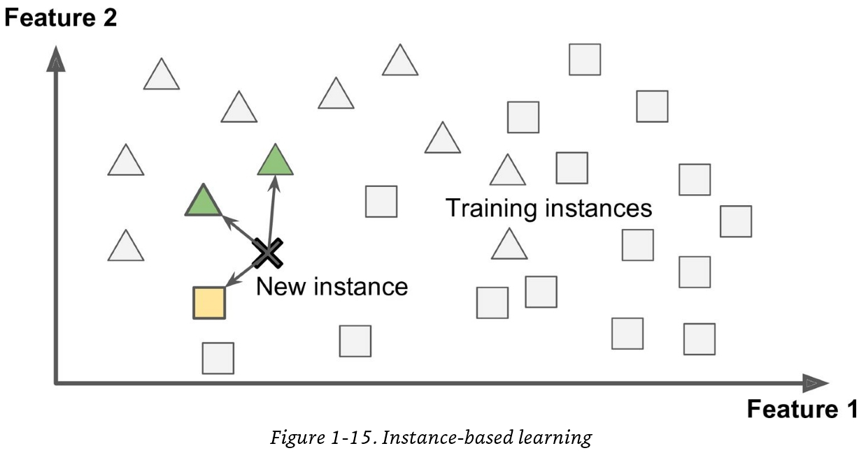
Instance-Based Learning
Problem solving is based on memory
These algorithms rely on direct similarity comparisons between data instances
kNN
(Image courtesy of Aurelien Geron, ML book)

Slide 30
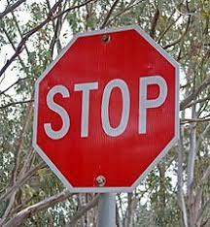
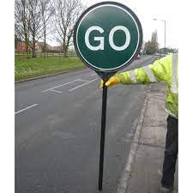
An Example…

Slide 31
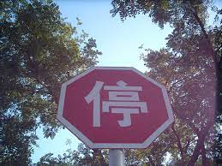
An Example…
?

Slide 32
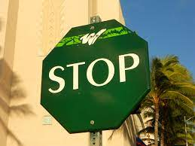
An Example…
?

Slide 33
“Lazy” Learners
Instance-based learning operates on the assumption that the similarities between data points are meaningful
“I know this because I have seen something similar before”

Slide 34
Instance-Based Learning
Advantages
Adapt to new data very quickly
Easily explainable algorithm
Easy to build (as you will see in the lab!)
Disadvantages
Ever increasing computational complexity
Resource intensive to run
Often fooled by irrelevant features

Slide 35
The kNN Algorithm
k-Nearest Neighbour Algorithm
Introduced in 1951 by two officers in the USAF
Fix, Evelyn, and Joseph Lawson Hodges. "Discriminatory analysis. Nonparametric discrimination: Consistency properties."
It has since grown to become closer to what we know of today

Slide 36
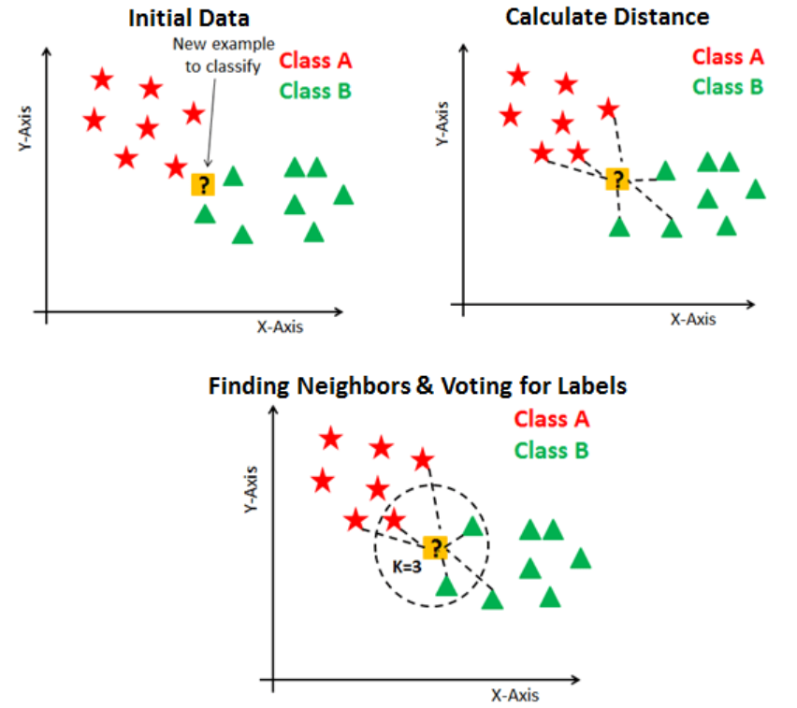
kNN Algorithm

Slide 37
kNN Algorithm

Slide 38
kNN Algorithm

Slide 39
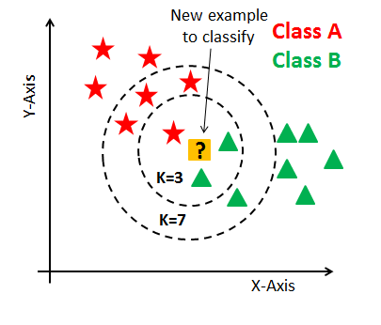
kNN Algorithm

Slide 40
kNN Algorithm Steps
The sequence of events is:
Input new instance
Compute similarity between new instance every historical instance
Order the historical instances based on their similarity
Vote on a class label using the top k neighbours
Output the label with the most votes
Let’s look at each stage in more detail

Slide 41
Input to the kNN Algorithm
Input to the kNN algorithm relies on data being in the form of numerical vectors
Some data is already in this format
i.e. tabular data
Data describing numerical features, associated with a label
See the iris dataset in todays lab
Some data will need to be converted using a representation learning method
i.e. text, images, etc
Raw data (more on representation learning later!)

Slide 42
Similarity Computation
Similarity functions:
Output is usually bounded
Higher numbers mean greater similarity (i.e. output of 1 means inputs are identical)
Distance functions:
Output is unbounded (there is a potentially infinite space)
Lower numbers mean greater similarity (i.e. output of 0 means inputs are identical)

Slide 43
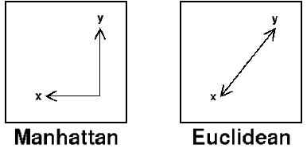
Distance Functions
There are many possible distance metrics, but we tend to focus on two in particular:

Slide 44
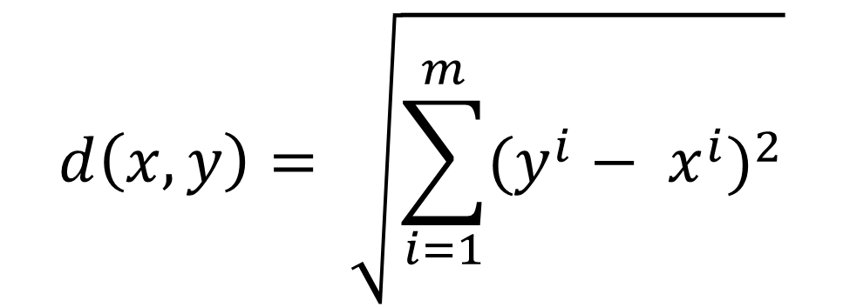
Euclidean Distance
The straight-line distance between two points
$$d\left(x, y\right)= \sqrt{\sum_{i=1}^{m}{(y^{i}− x^{i})^{2}}}$$

Slide 45
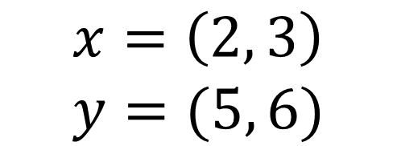
Euclidean Distance
The straight-line distance between two points
$$d\left(x, y\right)= \sqrt{\sum_{i=1}^{m}{(y^{i}− x^{i})^{2}}}$$
$$x=\left(2, 3\right) \\ y=(5, 6)$$

Slide 46
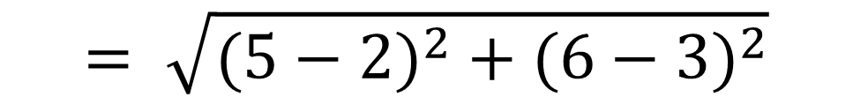
Euclidean Distance
The straight-line distance between two points
$$d\left(x, y\right)= \sqrt{\sum_{i=1}^{m}{(y^{i}− x^{i})^{2}}}$$
$$x=\left(2, 3\right) \\ y=(5, 6)$$
$$= \sqrt{(5−2)^{2}+(6−3)^{2}}$$

Slide 47

Euclidean Distance
The straight-line distance between two points
$$d\left(x, y\right)= \sqrt{\sum_{i=1}^{m}{(y^{i}− x^{i})^{2}}}$$
$$x=\left(2, 3\right) \\ y=(5, 6)$$
$$= \sqrt{(5−2)^{2}+(6−3)^{2}}$$
$$= \sqrt{9+9}$$

Slide 48


Euclidean Distance
The straight-line distance between two points
$$d\left(x, y\right)= \sqrt{\sum_{i=1}^{m}{(y^{i}− x^{i})^{2}}}$$
$$x=\left(2, 3\right) \\ y=(5, 6)$$
$$= \sqrt{(5−2)^{2}+(6−3)^{2}}$$
$$= \sqrt{9+9}$$
$$= \sqrt{18}$$
$$=4.24$$

Slide 49
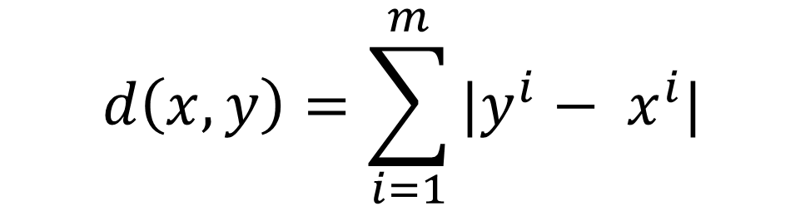
Manhattan Distance
Also called the Taxicab distance
$$d\left(x, y\right)=\sum_{i=1}^{m}{|y^{i}− x^{i}|}$$

Slide 50
Manhattan Distance
Also called the Taxicab distance
$$d\left(x, y\right)=\sum_{i=1}^{m}{|y^{i}− x^{i}|}$$
$$x=\left(2, 3\right) \\ y=(5, 6)$$

Slide 51
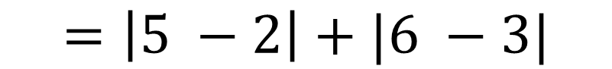
Manhattan Distance
Also called the Taxicab distance
$$d\left(x, y\right)=\sum_{i=1}^{m}{|y^{i}− x^{i}|}$$
$$=\left|5 −2\right|+|6 −3|$$
$$x=\left(2, 3\right) \\ y=(5, 6)$$

Slide 52


Manhattan Distance
Also called the Taxicab distance
$$d\left(x, y\right)=\sum_{i=1}^{m}{|y^{i}− x^{i}|}$$
$$=\left|5 −2\right|+|6 −3|$$
$$x=\left(2, 3\right) \\ y=(5, 6)$$
$$=3+3$$
$$=6$$

Slide 53
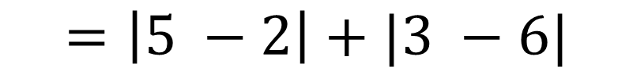
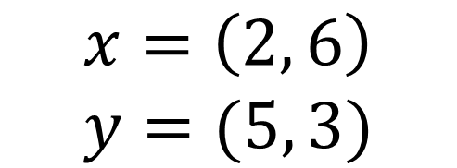
Manhattan Distance
Notice that there would be no difference to the results if the answer was -3 instead of positive 3 here.
Also called the Taxicab distance
$$d\left(x, y\right)=\sum_{i=1}^{m}{|y^{i}− x^{i}|}$$
$$=\left|5 −2\right|+|3 −6|$$
$$x=\left(2, 6\right) \\ y=(5, 3)$$
$$=3+3$$
$$=6$$

Slide 54
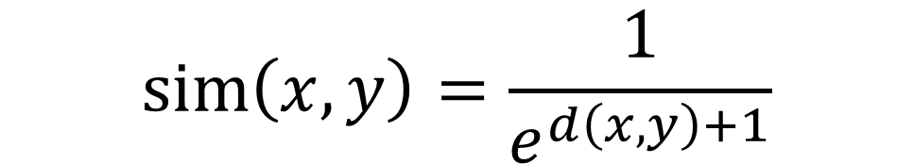
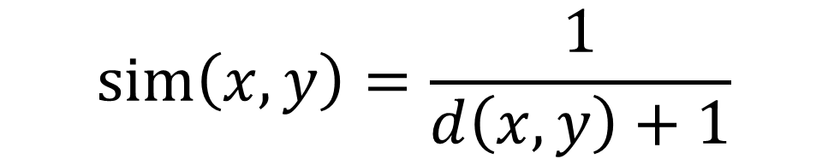
Convert Distance to Similarity
$$sim\left(x, y\right)=\frac{1}{d\left(x,y\right)+1}$$
$$sim\left(x, y\right)=\frac{1}{e^{d\left(x,y\right)+1}}$$

Slide 55
Similarity Functions
Distance functions measure the distance between two points
Similarity functions tend to measure the difference in direction with reference to magnitude
Direction – Angle from origin
Magnitude – Distance from the origin
B
A

Slide 56
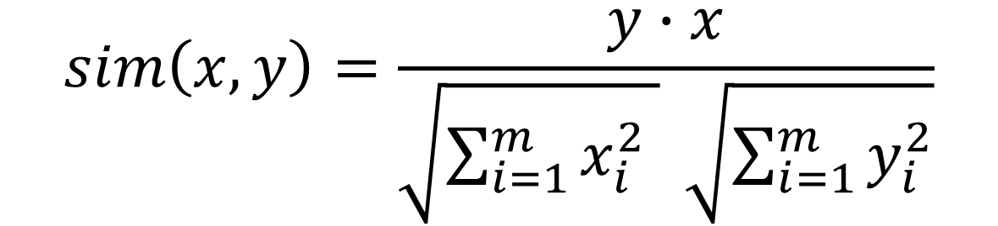
Dot Product and Cosine Similarity
Measures the differences in direction
Measures the differences in direction normalised by magnitude
$sim\left(x, y\right)=\sum_{i=1}^{m}{y^{i}x^{i}}=y∙x$
$$sim\left(x, y\right)=\frac{y∙x}{\sqrt{\sum_{i=1}^{m}{x_{i}^{2} }} \sqrt{\sum_{i=1}^{m}{y_{i}^{2}}}}$$

Slide 57
Ranking Neighbours
After the similarity calculation, every instance in the dataset is ranked by its similarity to the query
The combination of these two steps is a time intensive process
Computational complexity of iterating through every instance and performing a similarity calculation – O = nd
Computational complexity of sorting a list – varies depending on sorting algorithm

Slide 58
Voting for a Class label
The voting stage has two hyperparameters which are essential for the kNN algorithm to function effectively
The k parameter
The vote weighting parameter

Slide 59
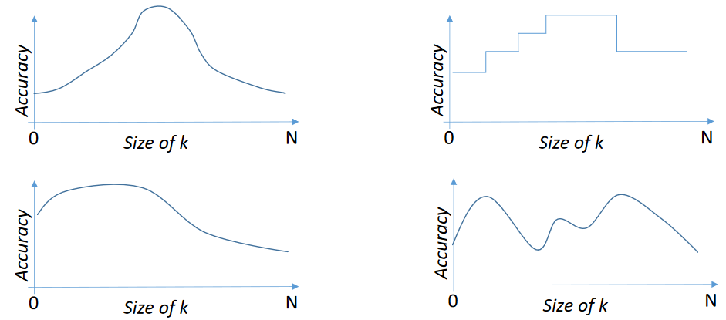
The k Parameter
The k parameter dictates how many neighbours to consider during the voting stage

Slide 60
The Vote Weighting Parameter
So now we know how many neighbours to consider
Should all neighbours have the same level of input?
If so, then simple majority vote is fine
Every neighbour casts a single vote for their own class label
If not, maybe more similar neighbours should get more of a say
Distance-weighted voting

Slide 61
The Vote Weighting Parameter
Sometimes it can make an enormous difference…
I was recently working with BT to develop an AI to help recommend the next step in a task pipeline for non-experts
I experimented with text representations and kNN to set a baseline
kNN, k = 3, no vote weighting – approx. 70% accuracy
kNN, k = 3, distance weighted voting, - approx. 98% accuracy

Slide 62
Output of the kNN Algorithm
Output of the algorithm is traditionally a single class label
However, it can in some scenarios be desirable to output the neighbours of your query instance
Identify the locality or region of the space
Find suitable ways to complete incomplete instances
Or to reuse similar solutions as before (more on this next week)

Slide 63
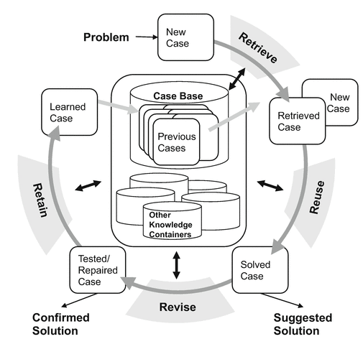
Case-Based Reasoning (CBR)
CBR is a methodology for reusing past experiences to solve new problems
Inspired by human memory
Like instance-based learners, uses memory
Unlike instance-based learners, is capable of adapting to new situations

Slide 64
What is a Case?
A ‘case’ is formed of three components
Problem – what are the features of the problem?
Solution – What are the features of the solution?
Outcome – Was this combination of problem-solution successful, or not?
Problem
Solution
Out
Quality
Explanation
Feedback
Question
Model Input
Explainer Output
Exp. Need
Explainer Algorithm
Data
Task
Model
System
No. Instances
Outcome
No. Features
Task
Sys. Info.
Algorithm
Eval. Meth.

Slide 65
Query Case
The CBR Cycle
Retrieve
Previous Cases
Comparison
Query Case
Previous Cases
Previous Cases
Solution
Query Case
Retain
Previous Cases
Solution
X
Solution
Solution
Solution
Solution
Accepted Solution
Solution
Solution
Solution
Solution
Solution
Solution
Case-Base
Query Case
Revise
Reuse
Proposed Solution

Slide 66
CBR vs Instance-Based Learning
CBR is a methodology
Instance-Based Learners are a group of algorithms
The individual components of a CBR system are implemented by different algorithms
One of these could be an instance-based learner
We refer to the different knowledge aspects used to implement CBR systems as knowledge containers
There are 4 – Case-Base, Similarity, Retrieval, Adaptation

Slide 67
The CBR Cycle
Vocabulary
How data is represented:
- What are the features and data types - Text, image, tabular, time-series, etc
Query Case
Query Case
Retrieve
Retrieve
Case-Base
Adaptation
Similarity
Comparison
Previous Cases
Comparison
Previous Cases
Query Case
Query Case
Previous Cases
Previous Cases
Previous Cases
Previous Cases
Query Case
Solution
Query Case
Solution
Previous Cases
Retain
Previous Cases
Retain
Solution
Solution
X
Solution
X
Solution
Solution
Solution
Solution
How cases can be revised:
In what circumstances to revise a decision
How much to revise
Solution
Solution
Solution
Solution
Accepted Solution
Solution
Accepted Solution
Solution
Solution
Solution
Solution
Solution
Solution
Solution
Solution
Solution
The cases stored in the case base
Solution
Case-Base
Case-Base
How data is compared:
- How to compare features (local) - How to compare cases (global)
Query Case
Query Case
Revise
Reuse
Revise
Reuse
Proposed Solution
Proposed Solution

Slide 68
The CBR Cycle - Retrieval
The retrieval stage relies on the case-base, vocabulary and similarity knowledge containers
What historical cases are stored, how are they represented and how to compare them
The retrieval stage mirrors what we have already learned about instance-based learners
Given a new case, identify similar cases in the case-base
Similarity can be calculated in different ways

Slide 69
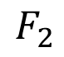
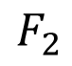
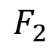
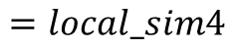
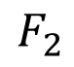
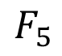
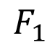
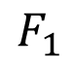
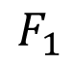
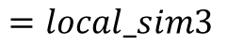
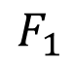
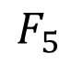
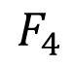
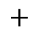
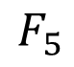















Local Similarity vs Global Similarity
We can calculate the similarity between each feature and aggregate
Or
We can compare each case and their features as a whole
Case 1
Case 2
Case 1
Case 2
$$F_{1}$$
$$F_{1}$$
$$=local_sim1$$
$$F_{1}$$
$$F_{1}$$
$$F_{2}$$
$$F_{2}$$
$$+$$
$$F_{2}$$
$$F_{2}$$
$$=local_sim2$$
$$∙$$
$$F_{3}$$
$$F_{3}$$
$$=sim$$
$$F_{3}$$
$$F_{3}$$
$$=global_sim=sim$$
$$+$$
$$F_{4}$$
$$F_{4}$$
$$=local_sim3$$
$$F_{4}$$
$$F_{4}$$
$$+$$
$$F_{5}$$
$$F_{5}$$
$$=local_sim4$$
$$F_{5}$$
$$F_{5}$$

Slide 70

Local Similarity Methods - Categorical
Similarity Table (or Matrix)
Provided by an expert, or elicited following a method

Slide 71

Local Similarity Methods - Categorical
Symbolic Hierarchy
Similarity calculated by number of ‘steps’ between two end points

Slide 72


Local Similarity Methods - Categorical
Taxonomy
An expert annotated graph of the relationships between features/cases

Slide 73

Local Similarity Methods - Numerical
Difference
Can be useful, but not bounded like other sim methods
Step Count
If the incremental difference is within a step count, sim = 1
Else sim = 0
Polynomial function
Similarity bounded between 0 – 1
For example: $\frac{\min\left(num1, num2\right)}{max⁡(num1,num2)}$

Slide 74


Local Similarity Methods - Numerical
Less/More is Perfect
Query
Price: £95K Miles Per Gallon: 40
Type: Sports
Colour: Black
Price: £100K Miles Per Gallon: 30
Type: Sports
Colour: Blue
Price: £80K Miles Per Gallon: 50
Type: Sports
Colour: Red

Slide 75
Local Similarity Methods – Text
String Matching
If str1 == str2, then sim = 1, else sim = 0
Character/Word Count
For comparing single/multi-word attributes respectively
Free-Text attributes
Term frequency of a known vocabulary
Named-Entity Recognition
Statistical methods (tf-idf)
Learned methods (word embeddings)

Slide 76

Local Similarity Methods – Text
Term Frequency – Inverse Document Frequency
Balances the frequency of words with how rarely they appear
Justification that rare words are important

Slide 77
Local Similarity Methods – Images
Template Matching
Given a known aspect you are looking for in an image, how similar is another image to this template (i.e. using intersect over union)
Image Features
Features elicited from images and then stored in another data type
For example – a count of how many faces, the colour distribution of the image, etc
Learn similarity using deep learners
Convolutional neural networks currently king
Deep Metric Learners – specific deep learners for learning similarity (my research focus throughout my PhD)

Slide 78
Local Similarity Methods – Time-Series
Whole Matching
Calculate similarity for the entire length of time-series data
Useful if entire time series is important (i.e. what made the price increase)
Subsequence Matching
Calculate similarity to specific sequences or windows within a piece of data
Useful if specific parts of the time-series are important (i.e. did it rain or not)
For each, we can use traditional similarity functions for each point in time-series data
Dimension reduction techniques
Transform example into numerical vector, allowing distance/similarity functions - for example, Discrete Cosine Transformation (DCT)

Slide 79
Global Similarity Methods
Global similarity metrics are any metrics which consider the entire case
Commonly used when a case is represented as:
All features of same data type
A single, unformatted feature (such as text, image or time-series)
This can include any local similarity methods, or can be vector-based methods discussed last week

Slide 80
The CBR Cycle – Reuse
If a single similar case has been retrieved:
The solution can be reused
If multiple cases have been retrieved:
The solutions can be aggregated for reuse
Label -> Voting (like kNN)
More complex outcome (i.e. pricing) -> similar cases can be averaged, etc
However, what if the solution is not suitable for reuse?

Slide 81
The CBR Cycle – Revise
During the revision stage, we adapt the retrieved solution so that it is more suitable for the new case
This is a key aspect of a CBR system
Unique among many other AI algorithms
Other AI have limited capacity to adapt

Slide 82

Adaptation – Types
Null
No adaptation
Transformation-Based
Substitution Transformations
Structural Transformations
Generative Adaptations

Slide 83
Adaptation – Transformative
Substitution
Replace (or UPDATE) part of the retrieved solution with one (or more) parts from other solutions
For example: update the colour of a made-to-order car
Structural
Change the structure of the solution by INSERTING or DELETING objects
For example: change a travel plan to going by train instead of car, as certain roads are closed/blocked

Slide 84
Adaptation – Generative
A new solution is generated
To enable this, knowledge is leveraged from the case-base and from why the retrieved solution could not be reused
Complex and expensive to do
Typically requires domain expertise to ensure suitability

Slide 85
Rules for When to Adapt
A common way to empower adaptation is to design a simple rule-based algorithm
When rules are met, case is adapted, otherwise not
Rules can be learned from the data
Derived from statistics
Or given by subject matter experts
Other methods for guiding adaptation are often domain-expert led
Remember, the system should be fit for purpose

Slide 86
The CBR Cycle – Retain
Finally, when a solution has been accepted, the case should be integrated into the case-base
Outcome is evaluated at this step
Or should it?
Pause for a moment and think – should every successful case be added to the case-base?
Should every unsuccessful case be omitted from the case-base?

Slide 87

Retain – Case-Base Maintenance
Ideally we want the case-base to be representative of the problem we are trying to solve
However, we want to avoid the case-base becoming expensive to search
Additionally, sometimes having knowledge of failed cases is a good thing
We can avoid them in future

Slide 88
Retain – Case-Base Maintenance Techniques
A common technique is to check distance between new case and existing cases
Make sure we are adding knowledge to the case-base
Sometimes case-base maintenance is performed separately to the retain stage
Run a separate algorithm to
Check for outliers, anomalies or clusters
Identify rarely used cases
Identify how use of case-base changes over time

Slide 89
The CBR Cycle – Recap
Vocabulary
How data is represented:
- What are the features and data types - Text, image, tabular, time-series, etc
Query Case
Query Case
Retrieve
Retrieve
Case-Base
Adaptation
Similarity
Comparison
Previous Cases
Comparison
Previous Cases
Query Case
Query Case
Previous Cases
Previous Cases
Previous Cases
Previous Cases
Query Case
Solution
Query Case
Solution
Previous Cases
Retain
Previous Cases
Retain
Solution
Solution
X
Solution
X
Solution
Solution
Solution
Solution
How cases can be revised:
In what circumstances to revise a decision
How much to revise
Solution
Solution
Solution
Solution
Accepted Solution
Solution
Accepted Solution
Solution
Solution
Solution
Solution
Solution
Solution
Solution
Solution
Solution
The cases stored in the case base
Solution
Case-Base
Case-Base
How data is compared:
- How to compare features (local) - How to compare cases (global)
Query Case
Query Case
Revise
Reuse
Revise
Reuse
Proposed Solution
Proposed Solution

Slide 90
CBR – Advantages and Disadvantages
Advantages
Adapt to new data very quickly (maintenance is easy)
Easily explainable methodology (features can be linked to decisions)
Intuitive (reminiscent of human expertise)
Solutions are always plausible within the domain
Disadvantages
Ever increasing computational complexity (for larger case-bases)
Resource intensive to run
Adaptation is really complex, meaning it is not always developed

Slide 91
Model-Based Learning

Slide 92

Model-Based Learning
Data is used to build a conceptual model of a problem
Typically mathematical – i.e. a function
This model is then used to solve new examples of the problem
Decision-Trees, Deep Learning, etc
(Image courtesy of OpenNN)

Slide 93



Representing Data to Make Decisions
Previously we looked at methods of making judgements about data by leveraging knowledge of similarity
What if this was very difficult?
Or rather, what if similarity was unsuitable but we just wanted to separate?

Slide 94



Data and Separability
Toy example
high risk low risk
BMI
 |  |  | BMI | Age | Risk
 | 1 |  | 40 | 80 | High
 | 2 |  | 45 | 70 | High
 | 3 |  | 35 | 20 | Low
 | 4 |  | 30 | 55 | Low
 | 16 |  | 27 | 33 | Low
 |  |  | X features |  | y classes
Instances
age

Slide 95
Learning to Separate
Our goal is to learn a function that can represent data for easy separation
?

Slide 96

Learning to Separate
Our goal is to learn a function that can represent data for easy separation
Deep Learning
Hidden layer

Slide 97
Neural Networks and Deep Learning
Neural networks are a specific type of machine learning algorithm which draw heavily from calculus
The basic idea is to learn a new representation of input data which is better optimised to achieve a certain objective
This means that NNs are currently the state-of-the-art for many problems relying on complex data as input
Images, Text, Time-Series…

Slide 98
Artificial Neural Network (ANN)
The ANN is effectively a calculus graph
A sequence of mathematical functions
They are comprised of neurons
All neurons at a given depth are called a layer
ANNs have at least three layers (but can have more)
Hidden layer
Image by Fei-Fei Li et. al.

Slide 99
A Single Neuron
Inputs
Neuron
Weights
Bias
Weighted sum
Activation
0.5
output
3.5
∑
-0.2
2
bias
8 0.8
1.2

Slide 100

A Single Neuron – Weights
T is transpose
$$z= W^{T}X= \sum_{i}^{m}{w_{i}x_{i}}$$
3.5
8
1.2
= (0.5 × 3.5 + -0.2 × 8 + 0.8 × 1.2) + b
= 1.11 + b
= 1.11 + 2
0.5 -0.2 0.8 ×
W X

Slide 101
A Single Neuron - Biases
z = w₁x₁ + · · · + w_{m}x_{m} + bias
z = w^{T}x + bias

Slide 102

Why do we need a bias?
x)=0
T
(w
x) >=0
T
(w
To provide flexibility when learning the decision boundary
We call it a bias since it biases the output up or down.
x) < 0
T
(w
Without bias the model can train over points passing through origin only

Slide 103
A Layer of Neurons – Densely Connected
Layer
Z values
2
∑
[3.55,
weights1 = [0.2, 0.8, -0.5]
weights2 = [0.5, -0.91, 0.26]
weights3 = [-0.27, 0.17, 0.87]
bias1
3
∑
1.92,
bias1 | = | 2
bias2 | = | 3
bias3 | = | 0.5
bias2
∑
2.5
2.65]
bias3

Slide 104

Activation Functions
To enable modelling of nonlinear problems
We will use them just after we get the result from weights and biases

Slide 105


Activation function - Sigmoid
Squashes the neuron’s pre- activation between 0 and 1
Always positive
Bounded
Strictly increasing
Think of it as a “gate”
Problems
Saturation can kill a neuron
Not zero centred (so constrains optimisation)
Exp() can be computationally expensive
𝑔(𝑧)
$$a\left(z\right)=\frac{1}{1+e^{z}}$$

Slide 106




Activation Functions - Sigmoid
Saturation still a problem But zero centered is nice Still expensive
𝑆𝑖𝑔𝑚𝑜𝑖𝑑(𝑧)
tanh(𝑧)
sigmoid$\left(z\right)=\frac{1}{1+e^{z}}$
tanh$\left(z\right)=\frac{e^{z}−e^{−z}}{e^{z}+e^{−z}}$

Slide 107



Activation Functions - Linear
[Mass et al., 2013] [He et al., 2015]
𝐿𝑒𝑎𝑘𝑦𝑅𝑒𝑙𝑢
𝐿𝑖𝑛𝑒𝑎𝑟
𝑅𝑒𝑙𝑢
𝑙𝑖𝑛𝑒𝑎𝑟 𝑧, 𝑚
= 𝑧 ∗ 𝑚
𝑅𝑒𝑙𝑢 𝑧
= max(0, 𝑧)
𝐿𝑒𝑎𝑘𝑦𝑅𝑒𝑙𝑢 𝑧
= max(𝛼𝑧, 𝑧)

Slide 108
Activated output from the layer
Neuron Layer
Z values
g values
Relu
Sigmoid
[2.75,
[0.93991335
[2.75
[2.75
-2
∑
a(2.75)
bias1
-0.08,
0.48001066
0.
-0.08*0.4
3
∑
a(−0.08)
bias2
∑
3.725]
a(3.725)
0.97645465]
3.725]
3.725]
2.5
bias3

Slide 109

Activation Functions - Softmax
Softmax functions are used to convert the output of a layer to a vector of probabilities
If data separation is not easy this will be hard!
This is useful for classification – we can calculate the probability that the input belongs to a certain class
We constrain the number of classes by the number of neurons in the output layer

Slide 110
Training ANN Algorithm - Overview
For e iteration of epochs
Do a forward pass
Compute the network loss
Backpropagate the loss in the current epoch
Use the gradients to update the weights
Notes:
How many epochs should we use ? That’s again another hyper parameter

Slide 111
Training ANN Algorithm - Overview
For e iteration of epochs (iterations)
Do a forward pass (what we just described)
Compute the network loss (error)
Backpropagate the loss in the current epoch (chain rule)
Use the gradients to update the weights (optimization)
Notes:
How many epochs should we use ? That’s again another hyper parameter

Slide 112
Epochs
Epochs are the hyperparameter which controls how often you repeat the cycle of forward-pass, calculate loss, backpropagate and update.
How do we decide the number of epochs?
Experimentation
Early-stopping
For example, if loss has not changed in x epochs

Slide 113
Forward Pass
During the forward pass – we effectively do exactly what we described in the first half of the lecture
First we initialise weights to random numbers
Typically small or within a normal distribution
Then we input our data
This is passed to the hidden layer, where at each neuron a new value is calculated based on weights and biases and adjusted by activation function
Then passed to the output layer, where hidden layer values are passed to another set of weights and biases and adjusted by (typically) a softmax function

Slide 114



Compute Loss – One Instance
$$loss\left(x\right)= \sum_{i}^{m}{y_{a}−y_{p}}$$
In the next step of training we calculate the network loss
Sometimes called error
The difference between our desired and actual output
Or our objective and what we actually received
For a softmax function this is straightforward
Desired class probability of 1, everything else 0
$$y_{a}$$
$$y_{p}$$
0
1
0
0
0
0.02
0.90
0.05
0.01
0.02

Slide 115



















Compute Loss – Network
For all training data …
Total Cost:
predicted
target
$$C\left(θ\right)=\sum_{i=1}^{N}{{loss}^{i}\left(θ\right)}$$
x¹
NN
$${\hat{y}}^{1}$$
$$\text{y}\text{1}$$
$${loss}^{1}\left(θ\right)$$
x²
NN
$${\hat{y}}^{2}$$
How bad the network parameters $θ$ are on this task
$$\text{y}\text{2}$$
$${loss}^{2}\left(θ\right)$$
x³
NN
$${\hat{y}}^{3}$$
$$\text{y}\text{3}$$
$${loss}^{3}\left(θ\right)$$
Find the network parameters $θ^{∗}$ that minimize this value
……
……
……
……
x^{N}
NN
$${\hat{y}}^{N}$$
$$\text{y}\text{N}$$
$${loss}^{N}\left(θ\right)$$

Slide 116
Backpropagation
Backpropagation is a fancy word for ‘chain rule’
The that if we know the rate of change between z -> y and between y -> x, we can calculate the rate of change between z -> x
In plain English, this means that we can break down complex functions into the composite parts
Typically we do this using derivatives

Slide 117






Measuring Impact of X on Y
No single slope.
Slope depends on where we measure it.
We can use some rules
e.g. Slope $f^{′}=2{ . 2 x}^{2−1}$
= $4x$
= $\frac{6−4}{3−2}$
Single slope $f^{′}=2$
Notes:
We care about the slope of the tangent line because it informs us about the impact that x has on this function at a particular point, referred to as the instantaneous rate of change. We will use this concept to determine the effect of a specific weight or bias on the overall loss function given a sample.

Slide 118


Computational Graphs
Efficient to compute forward and backward pass maths
Programmatical conveniences
# Forward pass
x = [1.0, -2.0, 3.0] # input values
w = [-3.0, -1.0, 2.0] # weights
b = 1.0 # bias
# Multiplying inputs by weights
xw0 = x[0] * w[0]
xw1 = x[1] * w[1]
xw2 = x[2] * w[2]
# Adding weighted inputs and a bias
z = xw0 + xw1 + xw2 + b
# ReLU activation function
output = max(z, 0)
Neuron
-3.0
output
1.0
$$∑$$
-1.0
-2.0
3.0
1
bias
3.0
f = max(0,
Relu
($\sum_{i=0}^{m}{w_{i}x_{i}+b) )}$

Slide 119
Computational graph – Forward Pass
1.0
x[0]
*
-3.0
w[0]
-3.0
Relu activation output
x[1]
-2.0
+
6.0
6.0
2.0
*
Loss
w[1]
-1.0
x[2]
3.0
6.0
*
w[2]
2.0
b
1.0
output = ReLU(sum(mul(x0, w0), mul(x1, w1), mul(x2, w2), b))
Notes:
to learn the impact of all of the inputs, weights, and biases to the neuron output and at the end of the loss function, we need to calculate the derivative of each operation performed during the forward pass in the neuron and the whole model. To do that and get answers, we’ll need to use the chain rule,
We are interested in the partial derivatives, a situation where we try to find the impact of the given input to the output while treating all of the other inputs as constants. We are interested in the impact of singular inputs since our goal, in the model, is to update parameters.
the gradient is a vector of the size of inputs containing partial derivative solutions with respect to each of the inputs.

Slide 120

Computational Graph – backward pass
1.0
x[0]
*
-3.0
w[0]
-3.0
1.0
Relu activation output
x[1]
-2.0
+
6.0
6.0
2.0
*
1.0
1.0
1.0
w[1]
-1.0
3.0
Calculus Rules
x[2]
6.0
$$f_{a}\left(x\right)=x+a → \frac{∂f}{∂x}=1$$
$f_{a}\left(x\right) =$ $x∗a$ $→$ $\frac{∂f}{∂x}=a$
$f_{a}\left(x\right) =$ $max(0,x)$ $→$ $\frac{∂f}{∂x}=\left\{\begin{aligned}0 if x≤0 \\ 1 if x>0\end{aligned}\right.$
*
2.0
1.0
w[2]
b
1.0
1.0
Notes:
For this example, let’s assume that our neuron receives a gradient of 1 from the next layer. We’re making up this value for demonstration purposes, and a value of 1 won’t change the values, which means that we can more easily show all of the processes. We are going to use the colour of red for derivatives

Slide 121
Computational Graph – backward pass
1.0
x[0]
-3.0
*
-3.0
w[0]
-3.0
1.0
1.0
Relu activation output
x[1]
-2.0
+
6.0
6.0
2.0
-1.0
*
1.0
1.0
1.0
w[1]
-1.0
-2.0
3.0
Calculus Rules
x[2]
6.0
$$f_{a}\left(x\right)=x+a → \frac{∂f}{∂x}=1$$
$f_{a}\left(x\right) =$ $x∗a$ $→$ $\frac{∂f}{∂x}=a$
$f_{a}\left(x\right) =$ $max(0,x)$ $→$ $\frac{∂f}{∂x}=\left\{\begin{aligned}0 if x≤0 \\ 1 if x>0\end{aligned}\right.$
2.0
*
2.0
1.0
w[2]
3.0
b
1.0
1.0
Notes:
For this example, let’s assume that our neuron receives a gradient of 1 from the next layer. We’re making up this value for demonstration purposes, and a value of 1 won’t change the values, which means that we can more easily show all of the processes. We are going to use the colour of red for derivatives

Slide 122




Another example:
b
Slides from Fei-fei Li, et. al 2017
Notes:
Closely examine the following slides if you want to really dive deeply into the mathematics behind backpropagation.

Slide 123


Another example:
$$−0.53$$
b
Slides from Fei-fei Li, et. al 2017

Slide 124


Another example:
$$−0.53$$
$$−0.53$$
b
Slides from Fei-fei Li, et. al 2017

Slide 125


Another example:
$$−0.20$$
$$−0.53$$
$$−0.53$$
b
Slides from Fei-fei Li, et. al 2017

Slide 126

Another example:
(-1) * (-0.20) = 0.20
$$0.20$$
$$−0.20$$
$$−0.53$$
$$−0.53$$
b
Slides from Fei-fei Li, et. al 2017

Slide 127


Another example:
$$0.20$$
$$0.20$$
$$−0.20$$
$$−0.53$$
$$−0.53$$
b
$$0.20$$
Slides from Fei-fei Li, et. al 2017

Slide 128


Another example:
$$0.20$$
$$0.20$$
$$0.20$$
$$0.20$$
$$−0.20$$
$$−0.53$$
$$−0.53$$
b
$$0.20$$
Slides from Fei-fei Li, et. al 2017

Slide 129


Another example:
$$=0.20∗−1.00$$
$$0.20$$
$$=0.20∗2.00$$
$$0.20$$
$$0.20$$
$$0.20$$
$$−0.20$$
$$−0.53$$
$$−0.53$$
b
$$0.20$$
Slides from Fei-fei Li, et. al 2017

Slide 130


Another example:
$$−2.00$$
$$0.20$$
$$0.40$$
$$0.20$$
$$0.20$$
$$0.20$$
$$−0.20$$
$$−0.53$$
$$−0.53$$
b
$$0.20$$
Slides from Fei-fei Li, et. al 2017

Slide 131












Group common functions:
$$f(w,x)=\frac{1}{1+e^{−({w_{0}x_{0}+w}_{0}x_{0}+b)}}$$
Sigmoid function
$$f(w,x)=\frac{1}{1+e^{−z}}$$
$$−2.00$$
$$0.20$$
$$0.40$$
$$0.20$$
Sigmoid function
$$−0.40$$
$$0.20$$
$$−0.53$$
$$0.20$$
$$−0.20$$
$$−0.53$$
$$−0.60$$
b
$$0.20$$
Slides from Fei-fei Li, et. al 2017

Slide 132
Group common functions:
$$f(w,x)=\frac{1}{1+e^{−({w_{0}x_{0}+w}_{0}x_{0}+b)}}$$
Sigmoid function
$$f(w,x)=\frac{1}{1+e^{−z}}$$
$$−2.00$$
$$0.20$$
$$0.40$$
$$0.20$$
Sigmoid function
$$−0.40$$
$$0.20$$
$$−0.53$$
$$0.20$$
$$−0.20$$
$$−0.53$$
$$−0.60$$
b
$$0.20$$
(0.73) * (1 - 0.73) = 0.2
= $(1 −g(x)) g(x) where g is the sigmoid function$

Slide 133


Local Gradients of Activations
Activation | Forward f | Backward f’
Linear | $$f\left(x\right)=mx+c$$ | $$f′\left(x\right)=m$$
Sigmoid | $$f\left(x\right)= \frac{1}{1+ e^{−x}}$$ | $$f′(x)=f(x)(1−f\left(x\right))$$
TanH | $$f\left(x\right)= \frac{2}{1+ e^{−2x}}−1$$ | $$f^{′}\left(x\right)=1− {f(x)}^{2}$$
Relu | $$f\left(x\right)= \left\{\begin{aligned}0 if x<0 \\ x if x ≥0\end{aligned}\right.$$ | $$f′\left(x\right)= \left\{\begin{aligned}0 if x<0 \\ 1 if x ≥0\end{aligned}\right.$$

Slide 134
Gradients in Layers
when inputs and outputs are vectors
The partial derivatives are a matrix
[2,
3,
2.5]
1.99
1
1
loss
$$Σ$$
2.99
2.49
2.01
1
1
dbiases
3.01
2.50
$$Σ$$
Backprop can make use of dot product to ensure gradients flow (as we did in the forward pass)

Slide 135
Updating the Weights
So using backpropagation we can allocate ‘blame’
i.e. we can identify which weights and biases have responsibility for a portion of the error in the loss function
How should we change the weights to improve network performance?
Hint: it’s an optimization function
We want to minimize error given a set of variables that contribute to it

Slide 136

Gradient Descent Optimization
Cost of error or Loss
Positive
gradient points in the direction of the greatest rate of increase of the function, and its magnitude is the slope of the graph in that direction.
∂L
∂w
> 0
∂L
∂w
< 0
Negative Gradient
Global minimum
Symbol for parameters is 𝞱
ANN has many parameters (weights, bias)
Notes:
In the gradient descent method of optimization, a hypothesis function, (i.e. the function to be approximated by our ANN)
is fitted to the training data set, by minimizing an associated cost(or loss or error), in terms of the parameters θ
In an ANN the main parameters are its weights and the bias values.
The idea then is to use gradient descent method , starting with a set of initial parameters (weights) and then follows an iterative procedure, changing the values of our weights so that the error decreases.
The error function describes how closely the hypothesis fits the data for a given choice of θ.
The question we need to ask here is how should the weights change to reduce the desired minimisation of the error?
The slope is marked on the graph and in this case it is a positive gradient.
We begin at a random point (i.e. initial weights) and then according to this picture we want to follow the downward direction,
so we move towards the left. This means we decrease w a little.
So we modify w, opposite to the direction of the gradient; this means decrease w when we have a positive gradient
We want to gradually move in that direction until the error curve becomes flat and doesn’t change. This is said to be convergence.
Note if we had started on the opposite side we have a negative gradient, so as we move downward we must increase w.
-------

Slide 137
Machine Learning for Modelling
Machine learning is a method to derive outcomes from your data by allowing the computer to ‘learn’ a model
We have discussed two methods for modelling data to anticipate outcomes
Similarity-based – instance-based, case-based reasoning
Model-based – artificial neural networks (leading to deep learning)

